Slide 1
NIPPON TRAINING COURSE
IHO – NIPPON FOUNDATION
ALUMNI SEMINAR
Talal Alabri

Slide 2
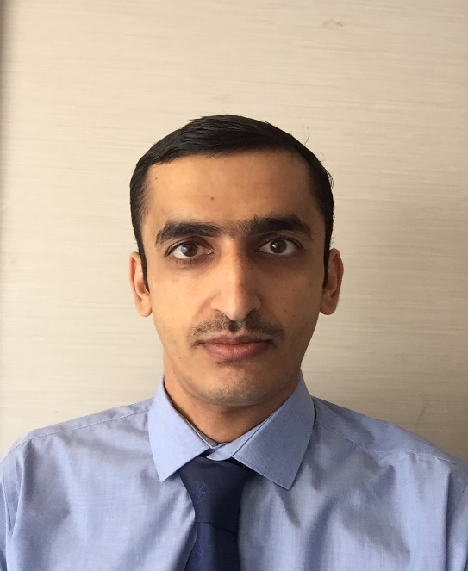
Self introduction
IHO – NIPPON FOUNDATION
ALUMNI SEMINAR
Name | TALAL ALABRI
Alumni year | 2011
Country | OMAN
Organization | OMAN NATIONAL HYDROGRAPHIC OFFICE
Position/Job title | Staff Officer2/ Nautical Charts
Current job description | Responsible for Production Section (ENC/Paper Charts)
Please put your photo here!

Slide 3
My career path and projects / Achievements
IHO – NIPPON FOUNDATION
ALUMNI SEMINAR
2009
2011
2012-2014
Join ONHO. Under training
Nippon Foundation course
Production Section
2014-2016
2017
2018-2019
Data Management Section
MSc GIS course (Dublin University of Technology)
SO2/ Nautical Charts

Slide 4
Lessons learned from CHART Course
IHO – NIPPON FOUNDATION
ALUMNI SEMINAR
Principles of cartography.
ENC/Paper charts concepts and the methodology of production.
Sounding selection skills.
Hydrographic data assessment.

Slide 5
Suggestion for the future
IHO – NIPPON FOUNDATION
ALUMNI SEMINAR
Presentations on IHO standards and Publications. The history and the future. S-100

